Slide 1
MOVIE MACHINE
A DEEP LEARNING MOVIE RECOMMENDATION PAGE
VASHISTH SHARMA
KANIKA BHAMBI
RAJESH KAGATHI
ANGANG LI
JOSH MUCHMORE
ROHAN MOHINDROO

Slide 2
PREMISE
In 2009, Netflix held a contest for $1 million for any developer(s) who could increase the accuracy of their recommendation engine by 10%!
Machine Learning concepts help us navigate massive datasets in order to program predictive models for future inputs given robust datasets
Given a data matrix of movies and their respective characteristics and ratings, let’s build an engine to accurately recommend movies to a user based on previous ratings inputs by them and all other users.
Use both supervised and unsupervised concepts to optimize our engine

Slide 3
APPROACH
Pre-Processing
Merging
Cleaning
Image Processing
Dark vs. Colorful Posters
Natural Language Processing
Tagline Sentiment Analysis
One Hot Encoding
Rescaling

Slide 4
APPROACH
Content-Based (Unsupervised)
Feature Scaling
Principal Component Analysis (PCA)
K-Means Clustering
Collaborative Filtering (Supervised)
“Surprise” Library & Singular Value Decomposition (SVD)
Grid Search
Test Model & Predict

Slide 5
RESOURCES
API calls from OMDB: OMDBI
Dataset: Kaggle from TMDb
“Surprise” Library
Python Pandas
Python Matplotlib
Python Flask
HTML/CSS/Bootstrap
Javascript D3.js
SQLite
Sci-Kit learn (Machine Learning)

Slide 6
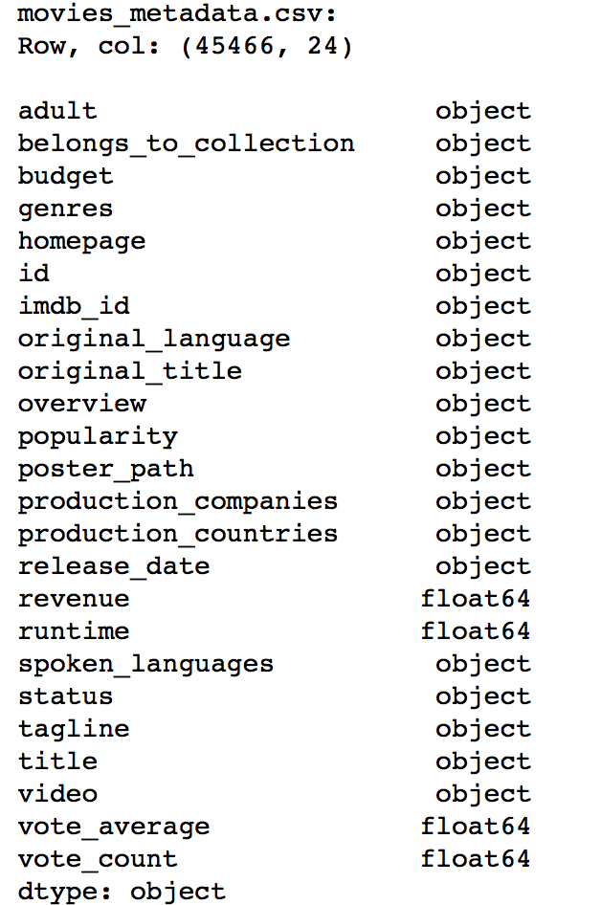
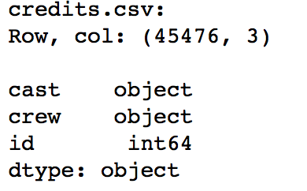
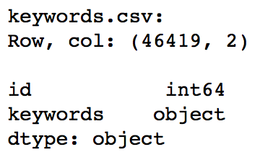
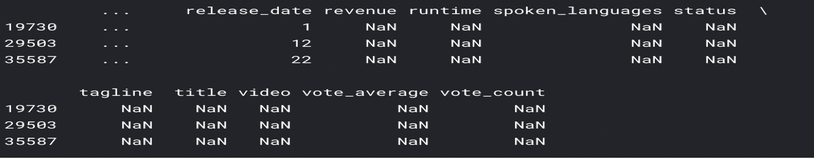
Data Cleaning
Load and merge tables

Slide 7
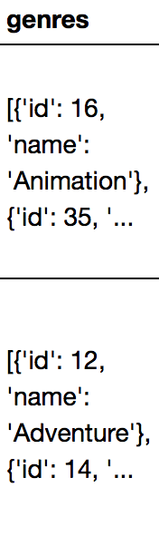
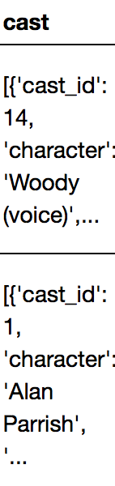
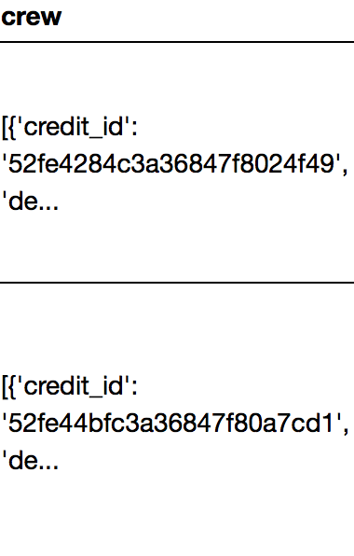
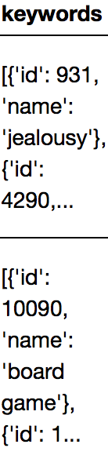
Data Cleaning
2. Clean features that have collections of data
………………..

Slide 8
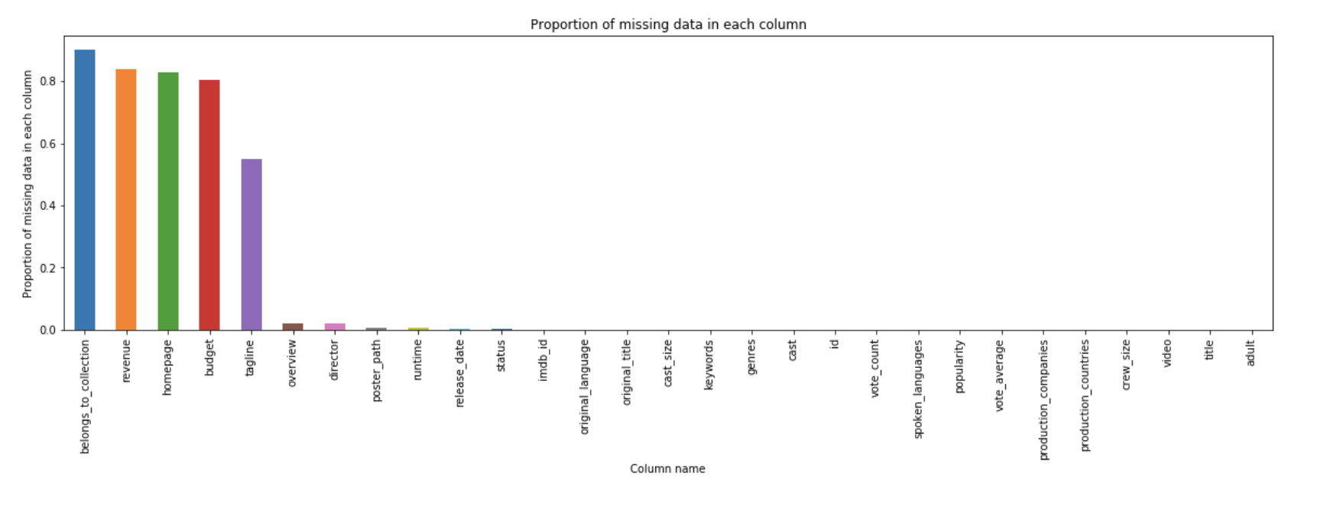
Data Cleaning
3. Assess missing values in each column

Slide 9
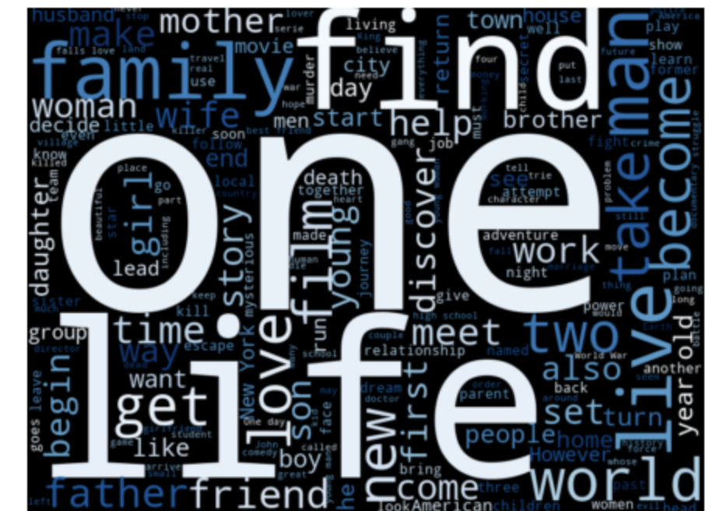
Data Cleaning
4. Feature engineering
4.1. Create weighted rating column
4.2. Process poster images to identify
darkness and colorfulness of the
overall image
4.3. Retrieve information from paragraphs
of text
4.4 Convert categorical features into
binary values
4.5. Re-encode other non-numeric features

Slide 10
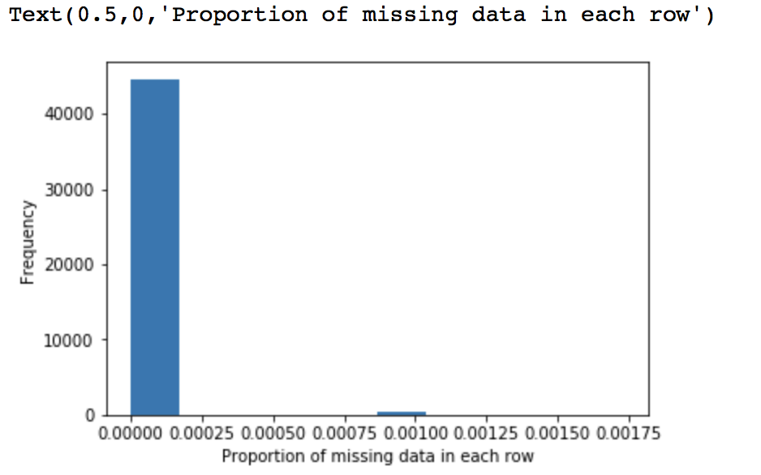
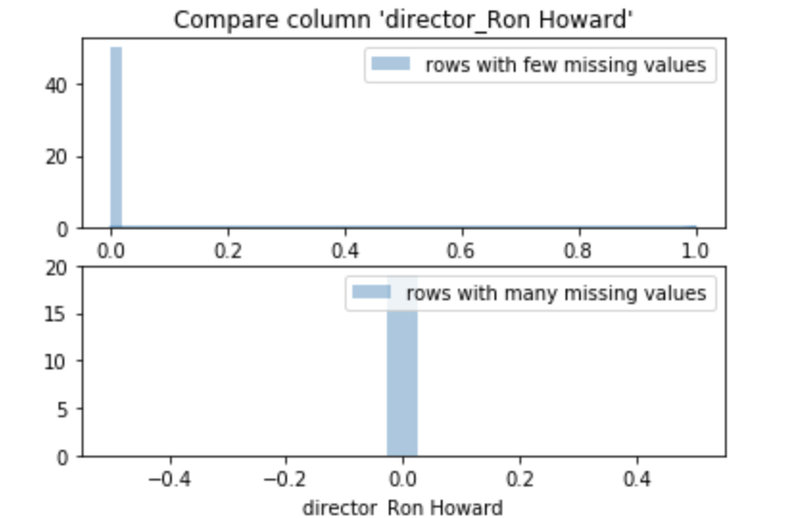
Data Cleaning
5. Assess missing data in each row

Slide 11
Data Cleaning
6. Feature scaling
First step to ML and important preprocessing step for many machine learning algorithms
We rescale the features such that they have the properties of a standard normal distribution with a mean of zero and a standard deviation of one

Slide 12
Recommendation model overview – new users
Recommend based on popularity

Slide 13



Recommendation model overview – new users
Content-based filtering
COLLABORATIVE FILTERING
liked
similar movies
recommend

Slide 14

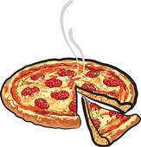
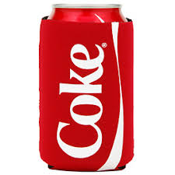
Recommendation model overview – new users
Content-based filtering
COLLABORATIVE FILTERING
liked
liked
liked
similar movies
recommend
recommend
liked

Slide 15
Recommendation model overview – new users
Content-based filtering
COLLABORATIVE FILTERING
liked
liked
liked
similar movies
recommend
recommend
liked
Hybrid method

Slide 16
Content-Based Recommender
Classifier ML model (K-means clustering)
Attempted to use all 1000+ features but:
All movies fell into one classification
Inspected which features were most heavily influencing classification

Slide 17
Content-Based Recommender
Dropped features appropriately to get a better distribution
Users average classification rating gets multiplied by the 'weighted rating' for best movies of that classification to generate a personalized rating for unrated movies
‘Personalized ratings' get put into a list sorted by highest rating and returned as recommendations

Slide 18
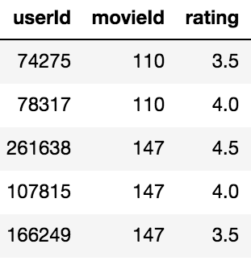
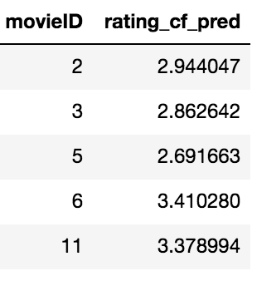
Collaborative filtering
userId = 1234

Slide 19
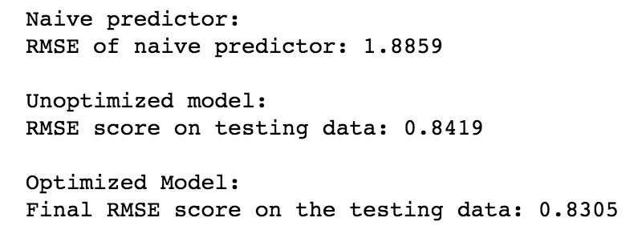
Collaborative filtering
Naïve predictor as baseline
SVD model tuning and evaluation
Predict user-specific ratings
Model: singular value decomposition (SVD)
Evaluation metric: rooted mean square error (RMSE)
userId = 1234

Slide 20
Movie Data
Movie Metadata (1000+ dimensions) from below fields
Genres
Language
Production Companies
Cast
Overview
Rating
User, Movie, Rating

Slide 21
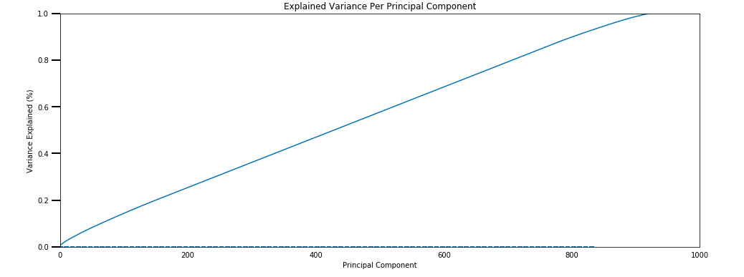
Movie Data

Slide 22
Process
Post cleansing of the Movie Metadata
PCA (Principal Components Analysis), process to narrow down the impactful dimension without losing the variance in the data
Left with 800+
Load data into Database
SQLite DB
Movie_metadata
Ratings

Slide 23
PROCESS TO OUTCOME
OBJECTIVE
Recommendation of movies as user interest evolves
Their rating
Hybrid combination of content-based(K-means clustering) and Collaborative filtering(matching users with similar ratings)
Ran the models individually for the these and took an average for the final rating.

Slide 24
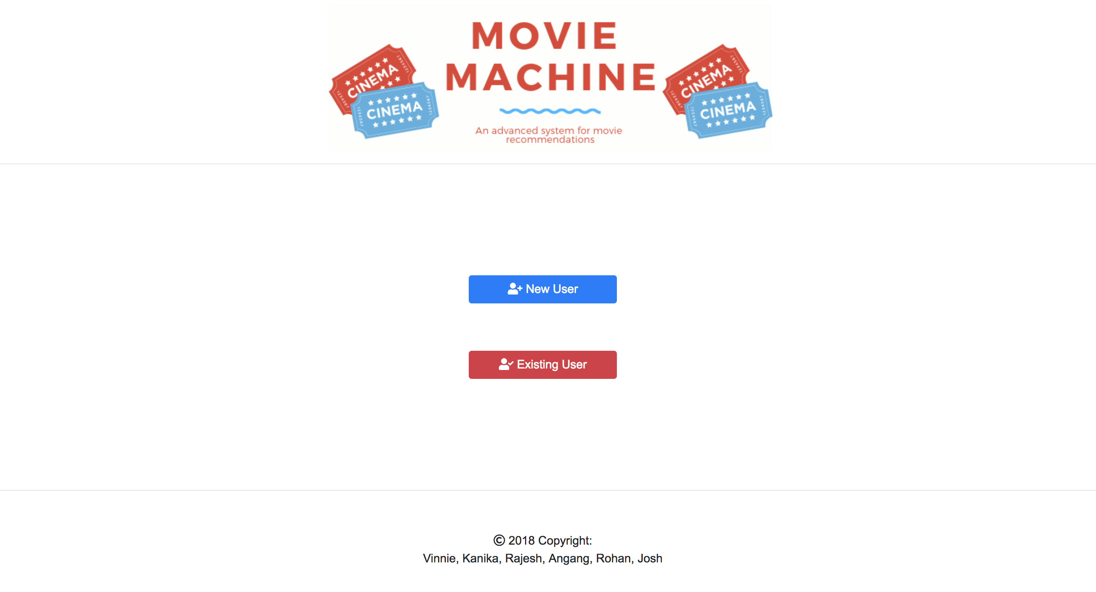
FINAL VISUALIZATION

Slide 25
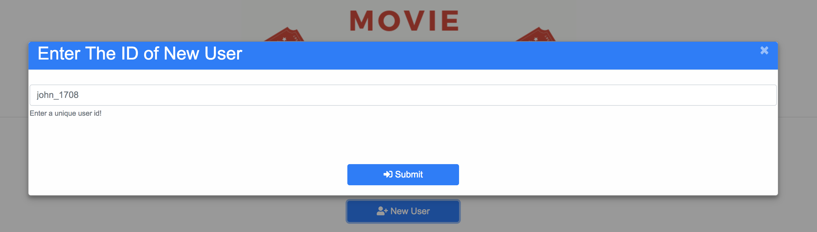
FINAL VISUALIZATION

Slide 26
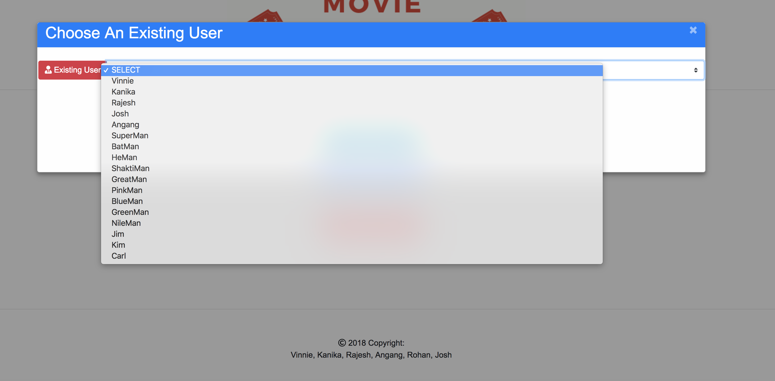
FINAL VISUALIZATION

Slide 27
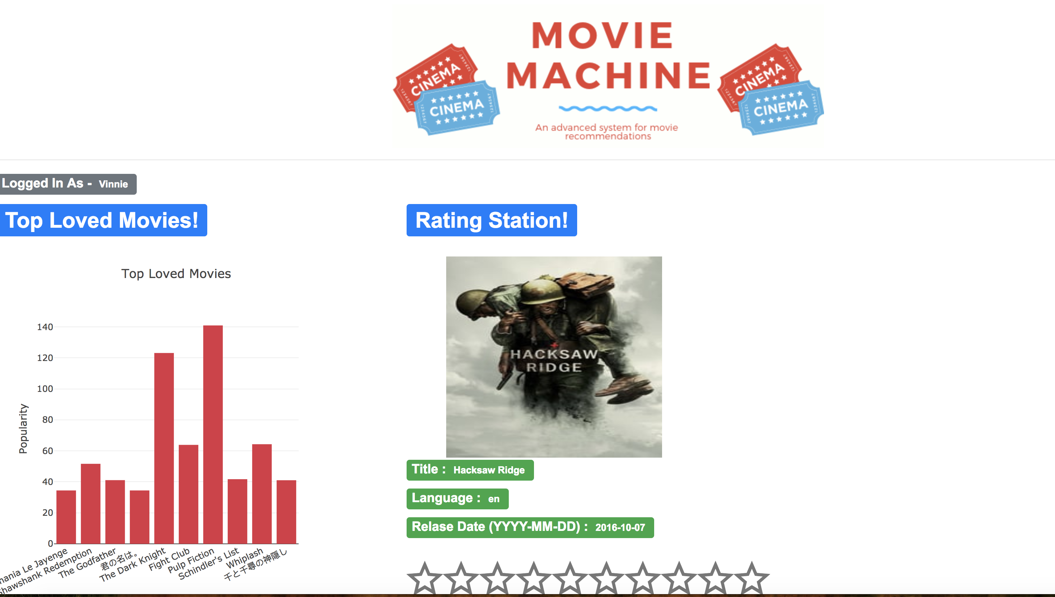
FINAL VISUALIZATION

Slide 28
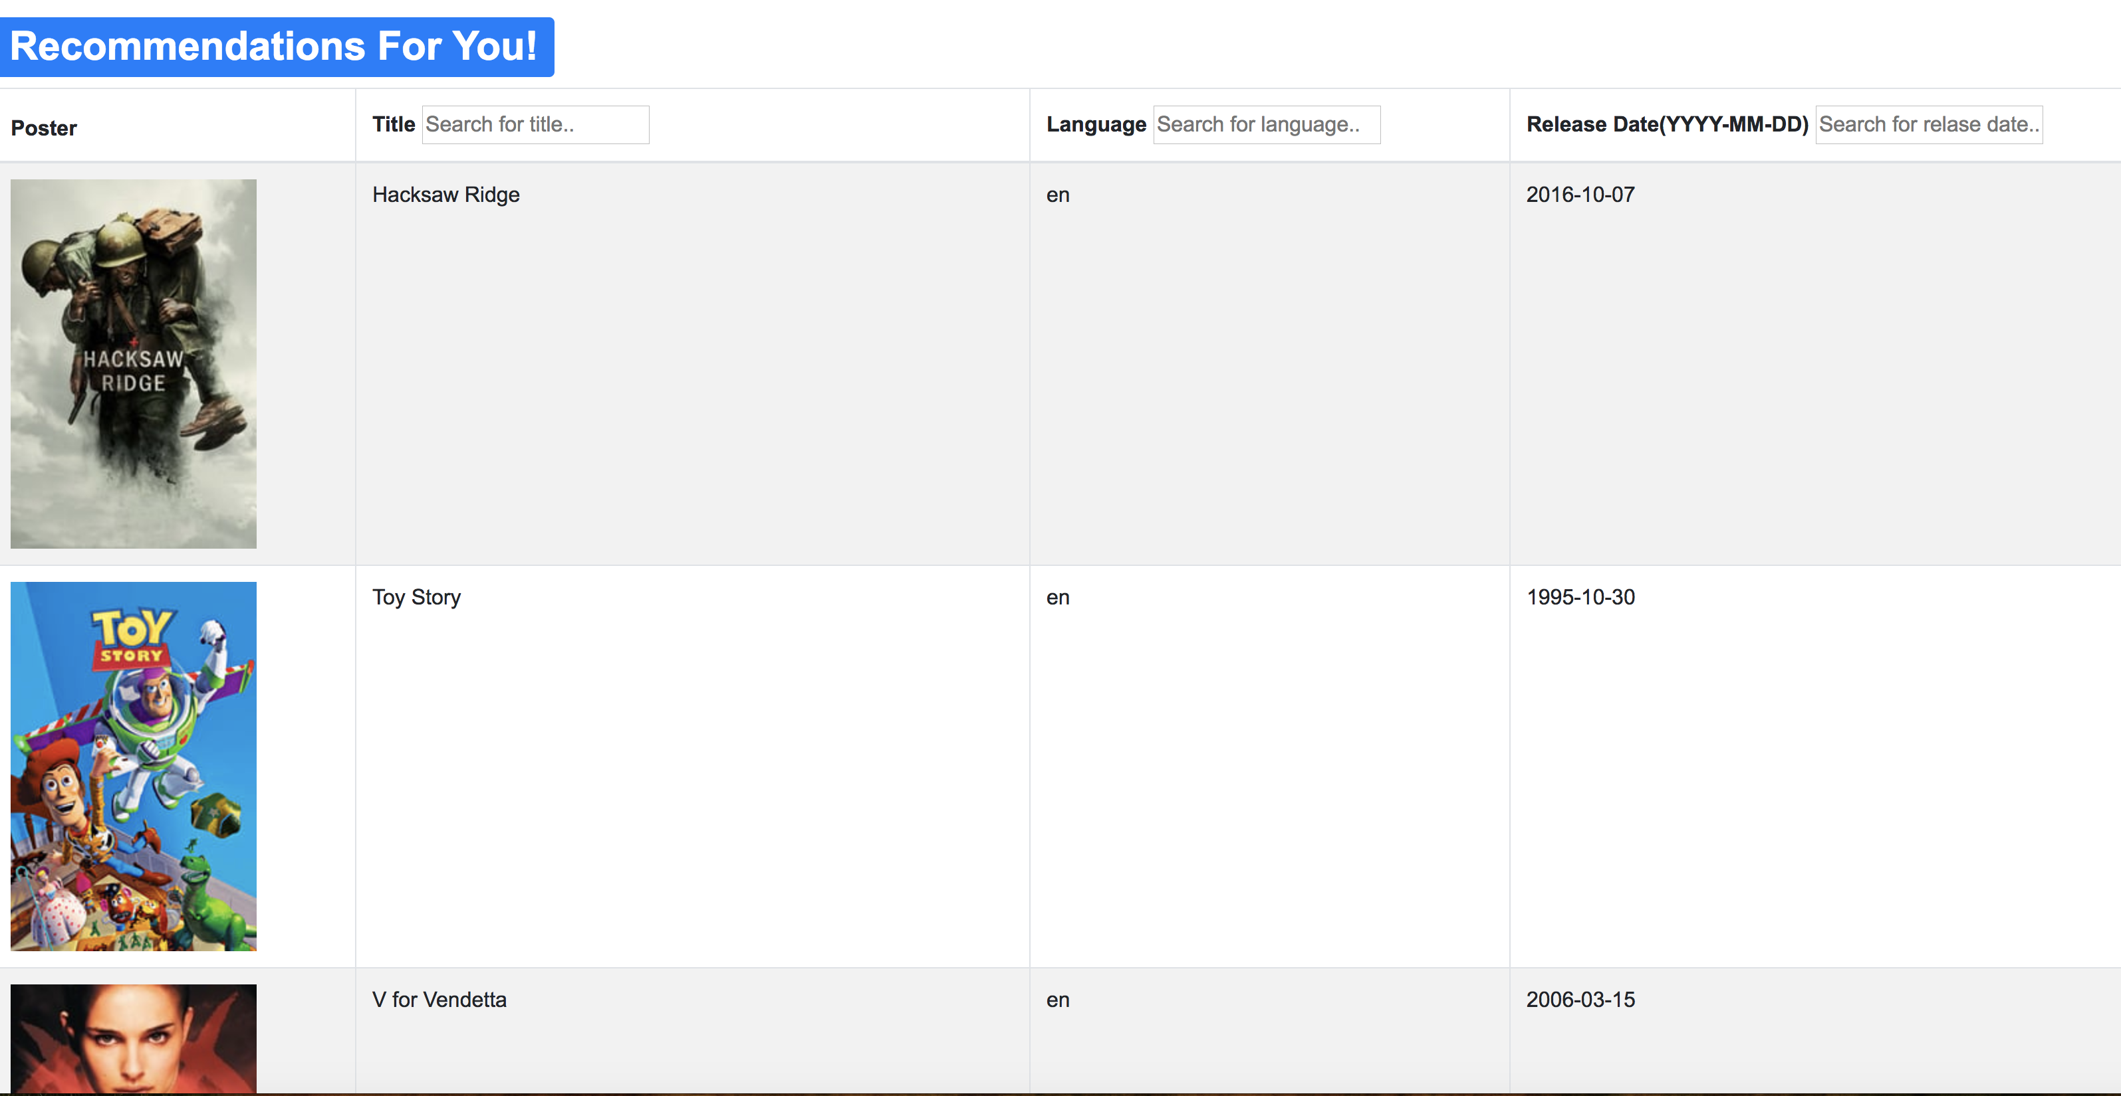
FINAL VISUALIZATION

Slide 29
APPLICATION DEMONSTRATION

Slide 30
Challenges & Limitations
Front-End Star Ratings
Data Type Conversions
Integrating Data Between Two Models
Image Processing
e.g. Image Entropy
Data size for collaborative filtering vs. training
Availability of awards data
Deployment to Publicly Hosted Domain

Slide 31
QUESTIONS?

